Slide 1


Navigating the Dungeons & Dragons of Your Career
Houston Miller
@HueyTheDM
Linkedin.com/in/houston-miller

Slide 2


DevSpace would like to thank our sponsors

Slide 3
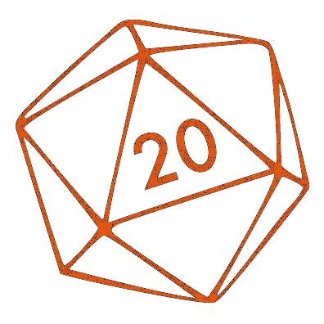
About Me
Developer for 8 years
Ministry Brands
Interface for churches to do online giving
Notes:
Playing DND or ~20 years

Slide 4
Inspiration
Similarities between Dungeons and Dragons and working on a development team
Notes:
DnD favorite hobby
Noticed things that are similar between career and hobby
Things I’ve done in DND and how they relate to development

Slide 5
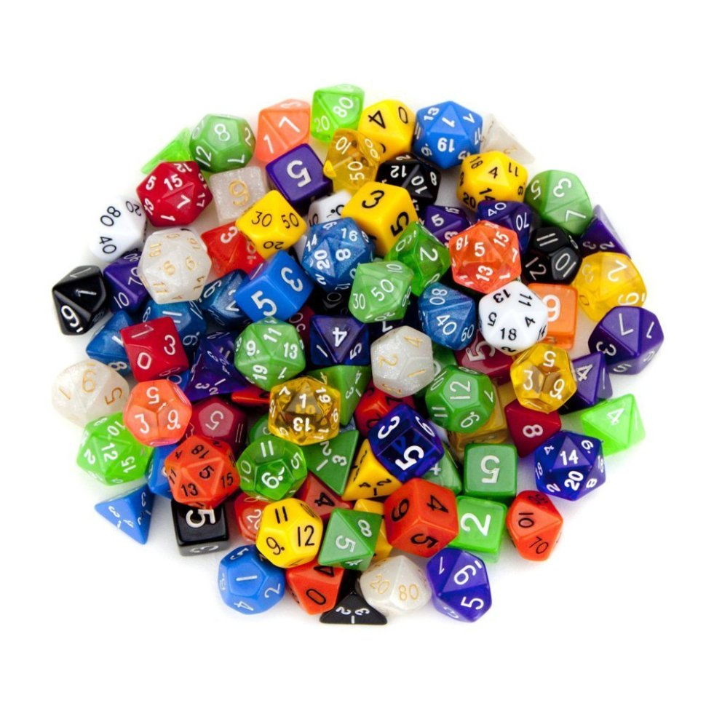
Dungeons and Dragons? What is that?
Collaborative tactical/storytelling game using imagination and chance
Cops and Robbers with dice and a referee

Slide 6
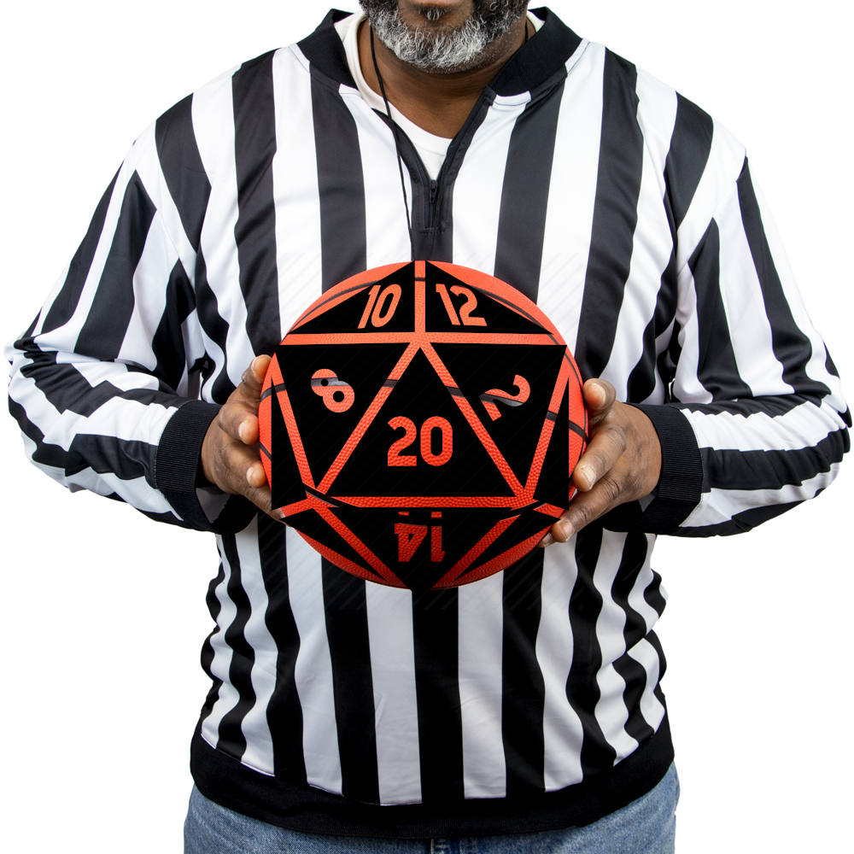
Dungeons and Dragons? What is that?
Dungeon Master (DM)
Referee, tells the players about the world and how the world reacts to them

Slide 7
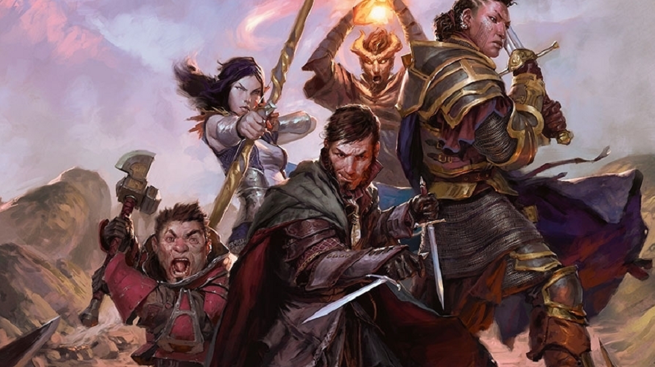
Dungeons and Dragons? What is that?
Players
Pretend to be characters they create and interact with the world

Slide 8
What D&D Has Taught Me
Yes, and…
Know when to speak up
Know when to be quiet
Team work and problem solving
Communication through storytelling

Slide 9
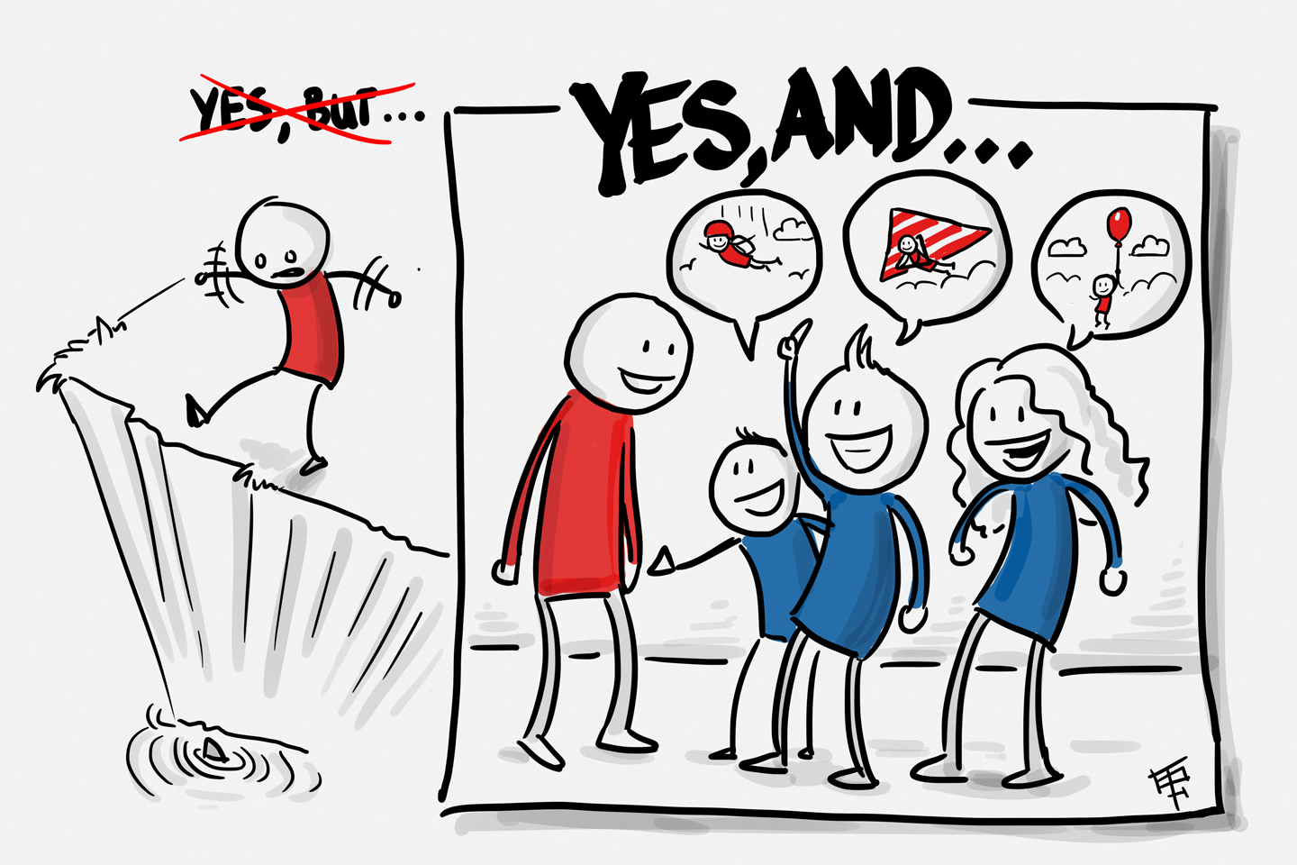
Say Yes, or Yes and…
Notes:
- Yes and is a tool used in improv, a skill that lends itself very easily to DnD

Slide 10
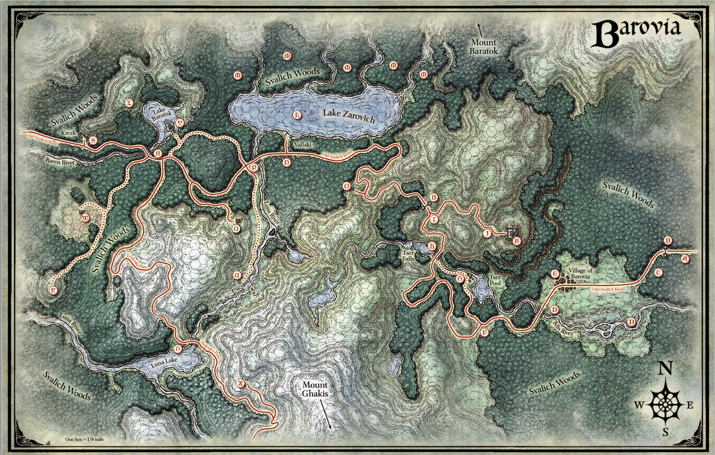
Notes:
Barovia – demiplane, surrounded by poisonous fog
Strahd – vampire lord, confined to realm

Slide 11
As A Dungeon Master
Just say yes
Unexpected stories and situations
Notes:
- Curse of Strahd, player wanted to start inside Barovia, though I wanted everyone to start outside
- Player was able to info dump, made for interesting character interactions later (untrusting of him)

Slide 12
As A Developer
Working with other developers
Pair programming
Mob programming
Trying new ideas
Notes:
recently, working on new project, needed to refactor something, looked like it was going to be a big job, said yes, got it done a lot quicker than we thought and code base is better for it.

Slide 13
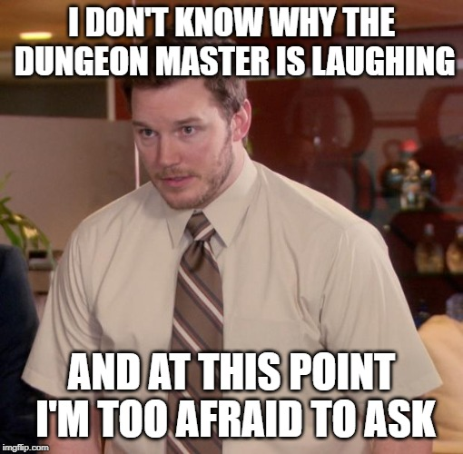
Knowing When to Speak Up

Slide 14
As A Dungeon Master
Explain a scene to the players
When they pull the wrong information out of it
When they make bad assumptions based on player knowledge vs character knowledge
Notes:
Telling players a scenario
They get the wrong information from it
Need to roll back and re-explain
Players using

Slide 15

As A Player
New player, overwhelmed with options
Big fight lots of enemies
Talk over options
Let her make the decision
Notes:
Another player, new to the game
Overwhelmed with options in big battle
Talk over ideas with her
Tell her we need the archers gone
She collapses bridge, kills the archers

Slide 16

As A Developer
Pair Programming
Perfectionism
Premature Optimization
Notes:
Mentorship!
Junior dev, coding down path that we have been down before, time to speak up
For loop vs ForEach
Teach why that path didn’t work for us, found too many out of range exceptions
Code cant be perfect first time
Don’t spend too much time there – this is good enough
Related - Premature optimization
Code Review is good time to point out how it can be better

Slide 17

Knowing When To Keep Quiet

Slide 18
As A Dungeon Master
Listen to your players
Use their ideas
Great stories from collaboration
Notes:
Players can come up with great ideas you never thought of
Use their ideas for (and against) them
Curse of Strahd, players thought ravens were bad guys. Played it up, reveal that they were good was bigger payoff

Slide 19
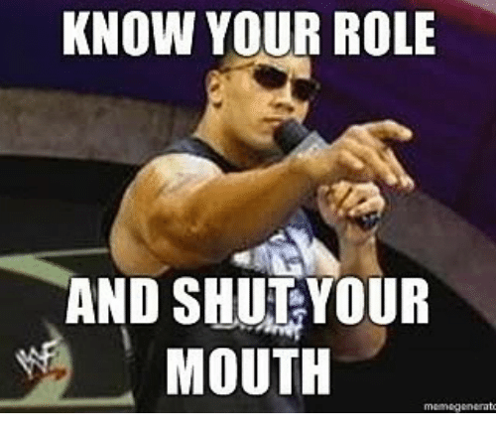
As A Player
I’m a rules lawyer
Don’t shout out rules to the Dungeon Master if she changes them
Don’t ruin other player’s fun
Notes:
Social Contract?
Someone else’s game, respect that
Don’t play someone else’s character – let them make the decisions for their character
Story: Fellow player made Aasimar warlock, which I had done in previous game. During PC creation she kept it secret.
Picked up on context clues (human with darkvision??), didn’t say anything because doing so would ruin her fun of that reveal later.

Slide 20

As A Developer
Pair Programming
Self teaching
No nitpicking
Notes:
Back to Junior Dev
Let them make some mistakes, they will learn from doing
Junior dev had written a function a few times, by the fourth one, he was able to see a lot of similarities, patterns, he refactored it then to make it better
No nitpicking whitespace, typos during pairing – wait till the end or during code review

Slide 21
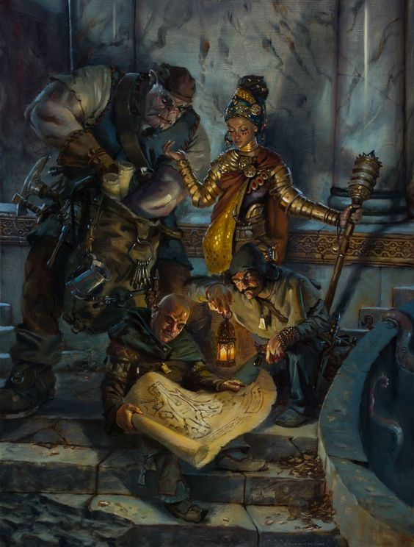
Teamwork

Slide 22
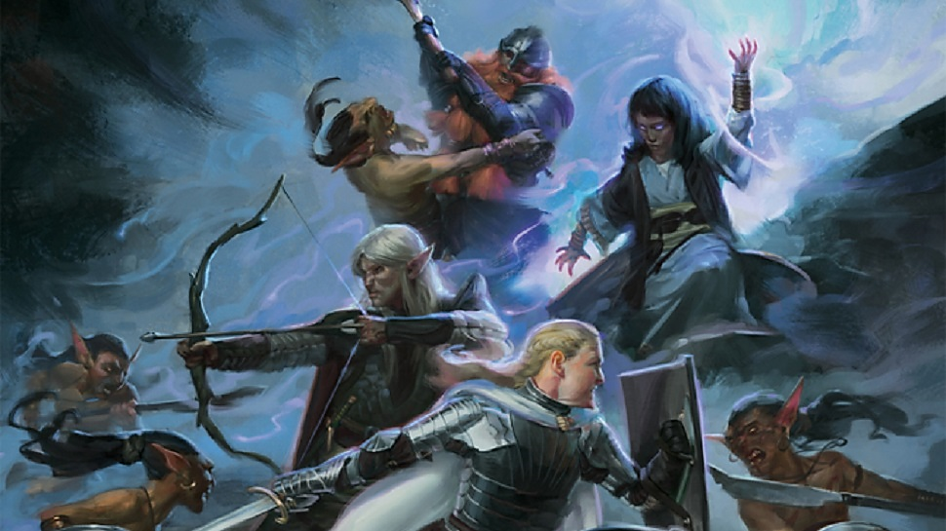
Teamwork and Problem Solving in D&D
Story time!
Notes:
Fighter, Rogue, Wizard in dungeon, come to dead end and see a statue
Fighter grew up in the mines, knows stonework says statue is newer than the rest of the work around here
Wizard sees glyphs on the statue no one can read – she casts Comprehend Languages reads out “I speak the truth”
Rogue, thinks to check the head of the statue, find a mechanism in the mouth
Push button, statue and secret door opens in

Slide 23

Teamwork and Problem Solving in Development
Story time!
Notes:
We had a hard feature to get out the door
Building powerpoints for customer with graphs
Researcher went in a figured out how to build excel charts programmatically and export them to PPT – he built that
One dev took the data and massaged it into useable format for new builder
One dev took care of the UI/UX

Slide 24
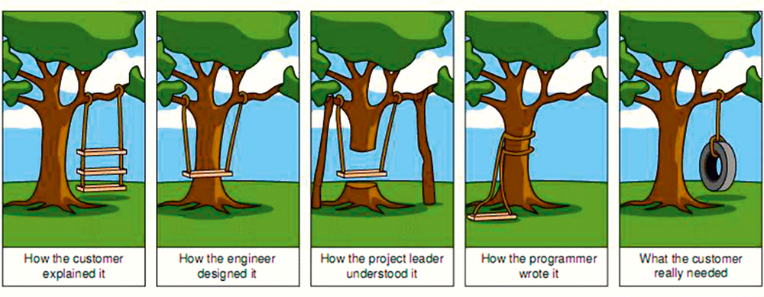
Communication

Slide 25
As A Dungeon Master
Explain yourself clearly
Underexplaining
Overexplaining

Slide 26
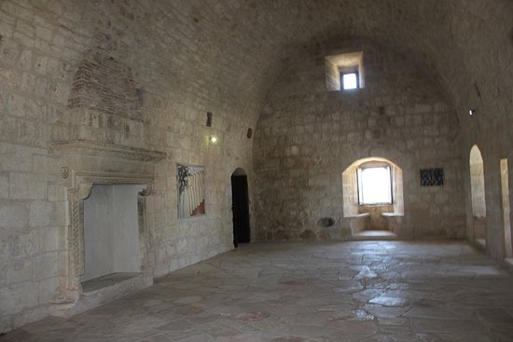
Underexplaining
Notes:
Underexplain – walk into a room and see a door on the other side
-boring and unengaging

Slide 27

Overexplaining
Notes:
Overexplain – You walk into a 15 by 15 ft room that has the scent of lingering body odor. There is a door across the way that is slightly ajar, maybe a few inches. There are several tapestries on the walls that depict battles between orcs and men. The table in the middle of the room has some half-eaten food and a few flies buzzing around it. The air tastes stale, and you can hear the sound dripping water from far off. Looking around the room, you notice the chandelier hanging from the ceiling with mostly burnt out candles, a few guttering their last breaths.
-descriptive, but too much so.
-players will get bored when they know there is something that needs to be taken care of (whoever just left the room)

Slide 28
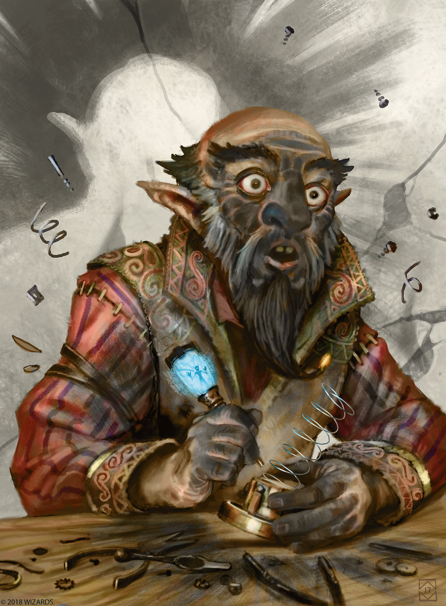
As A Player
Underexplaining
Can lead to unintended consequences
Explain action as well as intent
Notes:
Saying “I search the room” is boring.
Call for ability check to find traps/treasures will be difficult
Saying “I search under the bed to see if there is any treasure that someone was squirreling away” – not only would a check not be required, I might put the treasure there, even if it was hidden behind a false panel on the wall

Slide 29
As A Developer
Underexplaining
Missed Acceptance Criteria
Re-explain back to the customer
Clearly, concisely
Reduces meetings later
Helps get it right the first time
Notes:
Missed Acceptance Criteria
-PPT example
-Multiple features that were similar, four different sets of data, 3 were bar charts, 1 was sand chart
-ignore fact that we showed these to the customer
Explaining yourself helps meetings to go more quickly if you can tell that you understand requirements

Slide 30
Final Thoughts
Your hobbies can influence your career and vice versa
Use this to your advantage
Notes:
- Whether knitting/cooking/underwater basket weaving

Slide 31
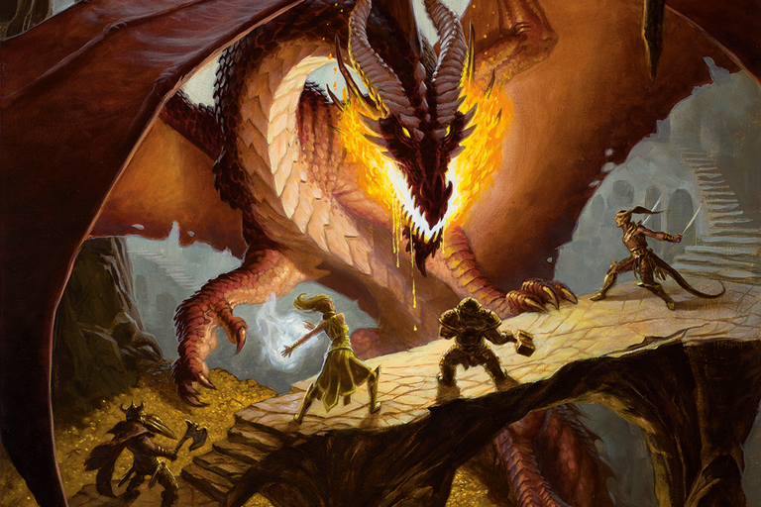
The
With
Dungeons and Dragons
Houston Miller
Talk
@HueyTheDM
Linkedin.com/in/houstonmiller

